Slide 1
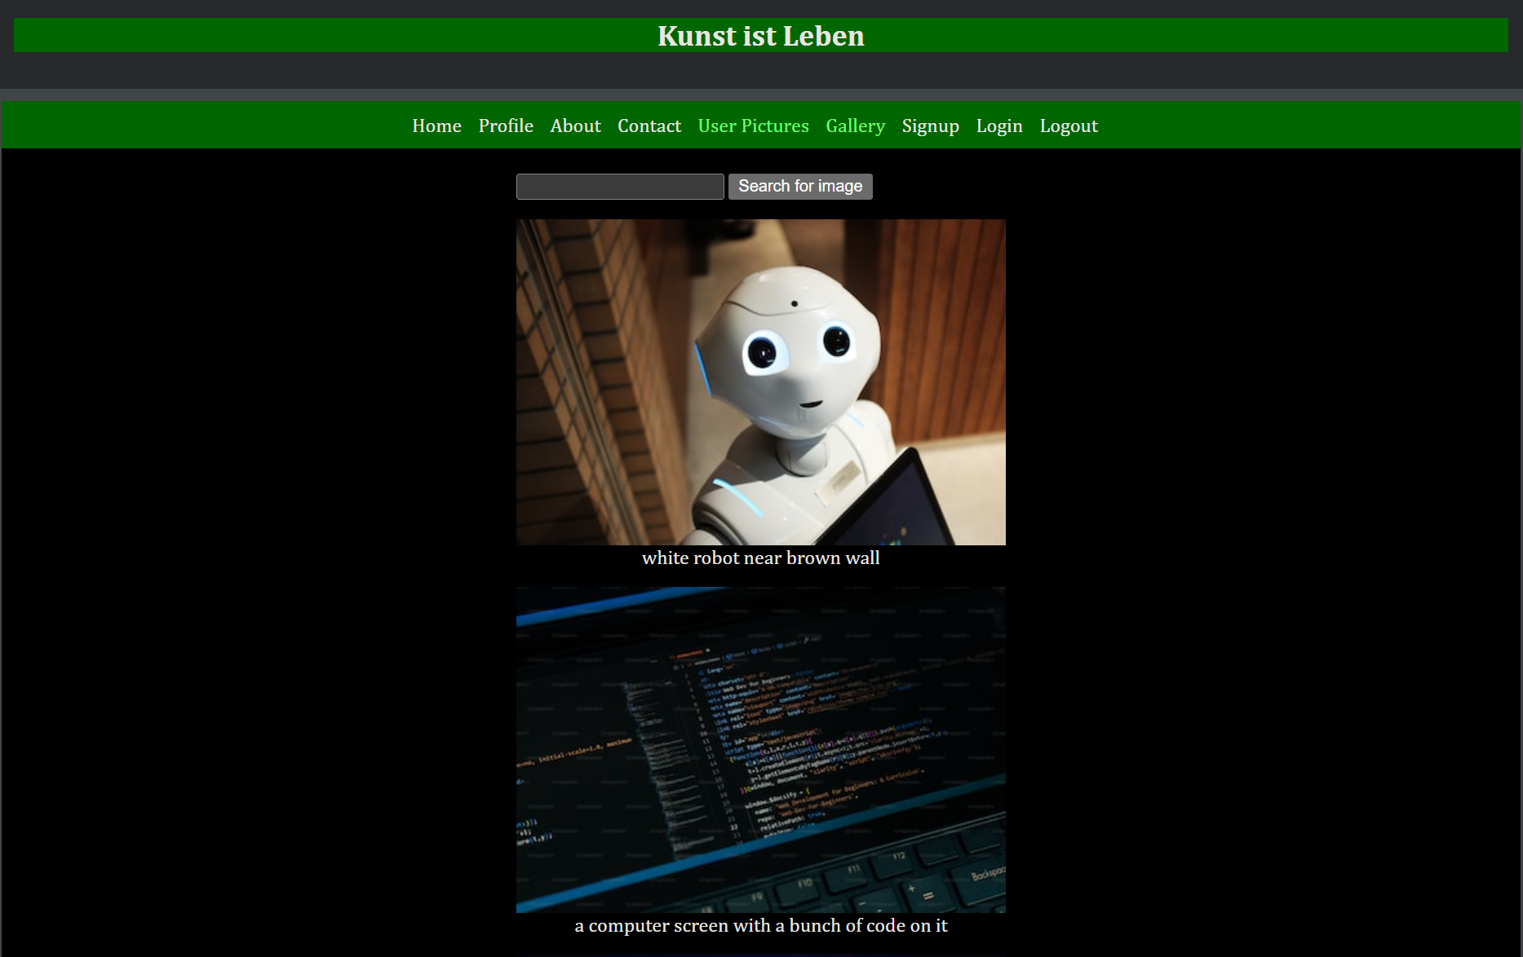
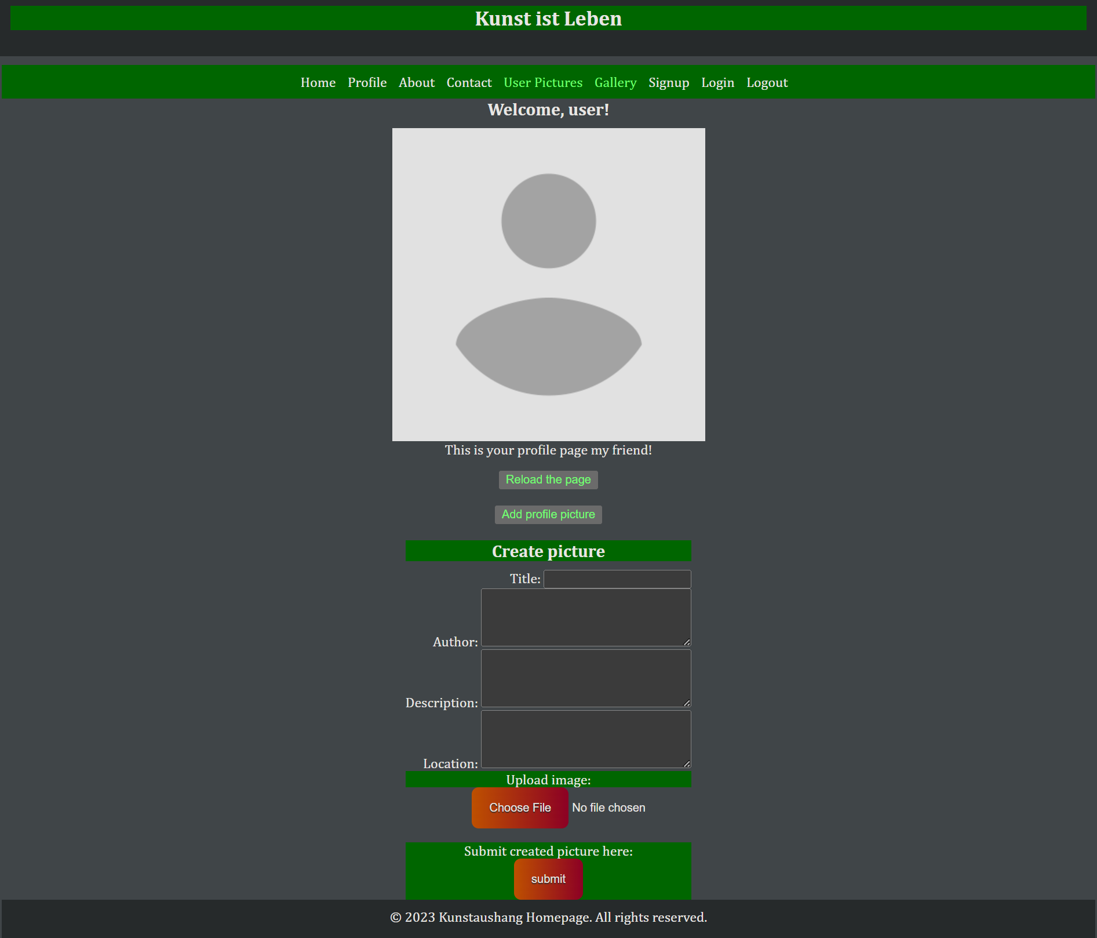
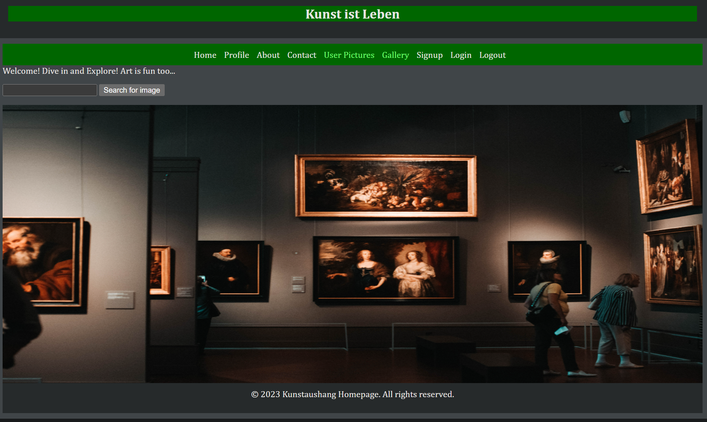
kunstaushang
Alexander Jasinski
Project #2
Ironhack Web Development Bootcamp
Berlin, 7/7/2023

Slide 2
About US
Neethu Vijaykumar
Sandra Ejiofor
Enoch Ampong
Alexander Jasinski

Slide 3
Project Elevator Pitch
Kunstaushang offers to the user an easy upload of their own pictures and artwork to the internet, showcasing their creativity to a global audience. This feature is based on the Cloudinary API.
The user can also upload his profile picture during sign-up and search for images using the built-in image search engine. It is built on the Unsplash-API and allows the user to explore a wide range of captivating images making it easy to discover new forms of art and gain inspiration.

Slide 4
Technical challenges
API Integration: Integrating and working with third-party APIs, such as Cloudinary and Unsplash, requires understanding their documentation, authentication mechanisms, and usage patterns
Search Functionality: Implementing a search feature using the APIs from Unsplash may require understanding and utilizing their search endpoints, query parameters, and result pagination
Authentication and User Management: Handling user registration, login, password hashing, session management, and secure access to protected routes
Database Integration: Connecting your application to MongoDB Atlas involves setting up the database connection, handling CRUD operations, managing data schemas

Slide 5
Big mistake
Not using wireframes before the web design stage.
Not using bootstrap for CSS styling.
No clear allocation of repository branches.
Not assisting with project management tools.

Slide 6
REPOSITORY
https://github.com/alexjasinski/kunstaushang

Slide 7
Thank you
BATTLE-OFJAVASCRIPT-TERMS
ALEXANDER JASINSKI

